Slide 1
Done so far & TImeline

Slide 2
Pre-processing
Break up text into sentences
Assign characters to sentences
Clean data
Delete copy-pasted sentences
Cut off pauses longer than 10 seconds
Create two csv files – sentences.csv, keystrokes.csv

Slide 3
Analyze
Statistics of
Pause length
Characters
Pause distribution
Index vs position

Slide 4
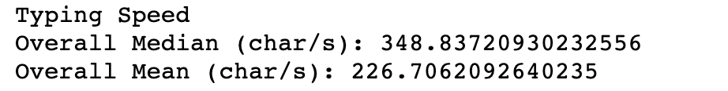

Slide 5
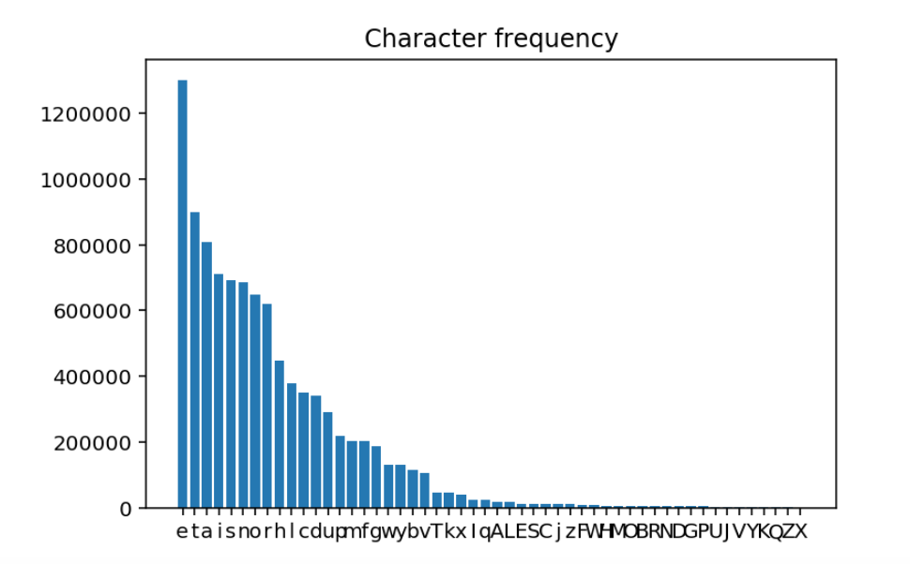

Slide 6
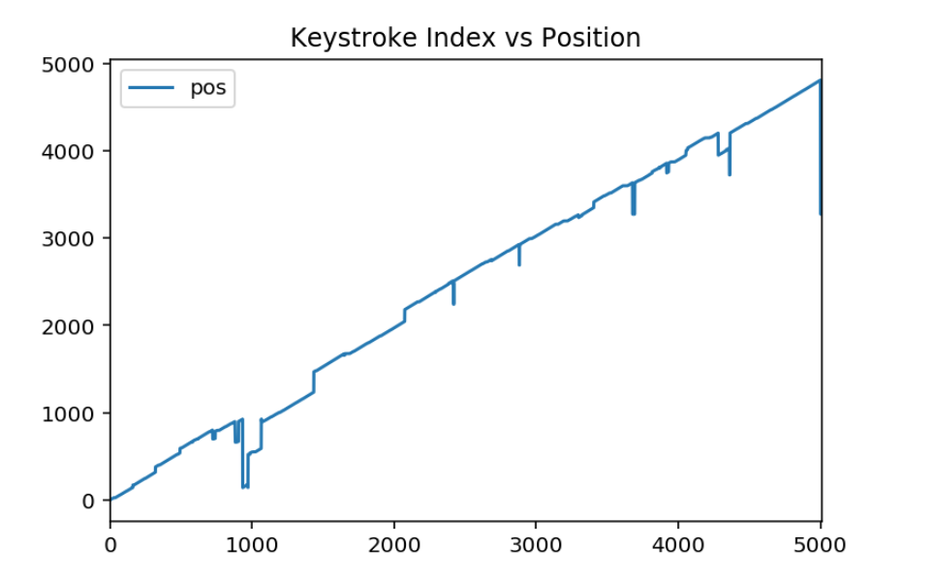

Slide 7
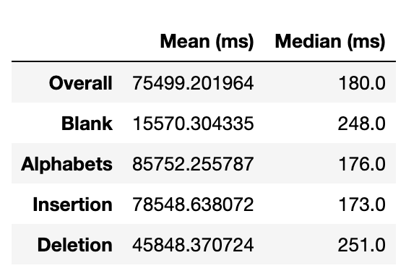
Pause Length Statistics

Slide 8
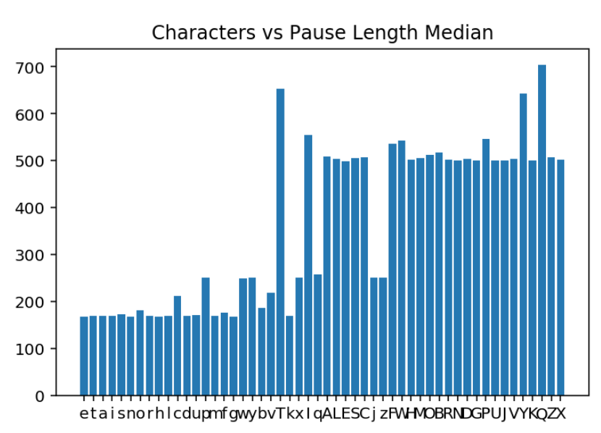

Slide 9
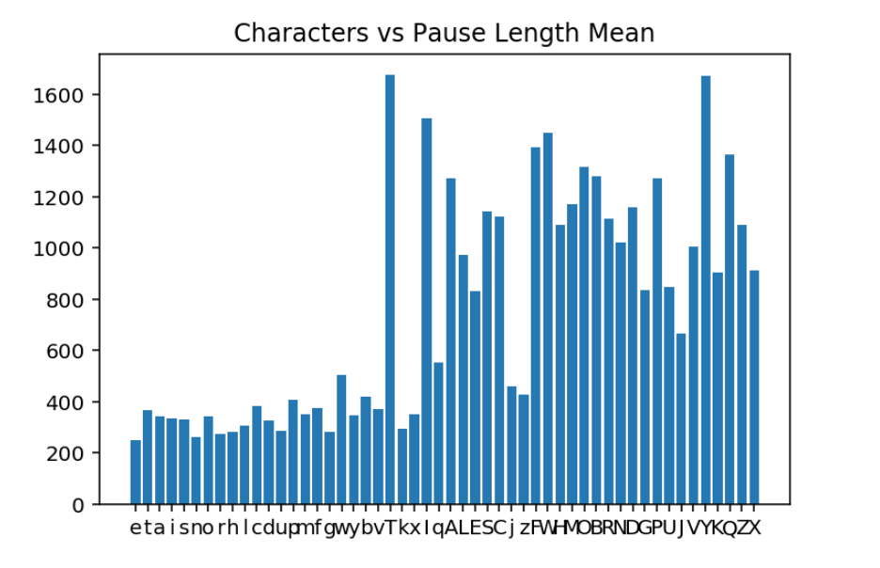

Slide 10
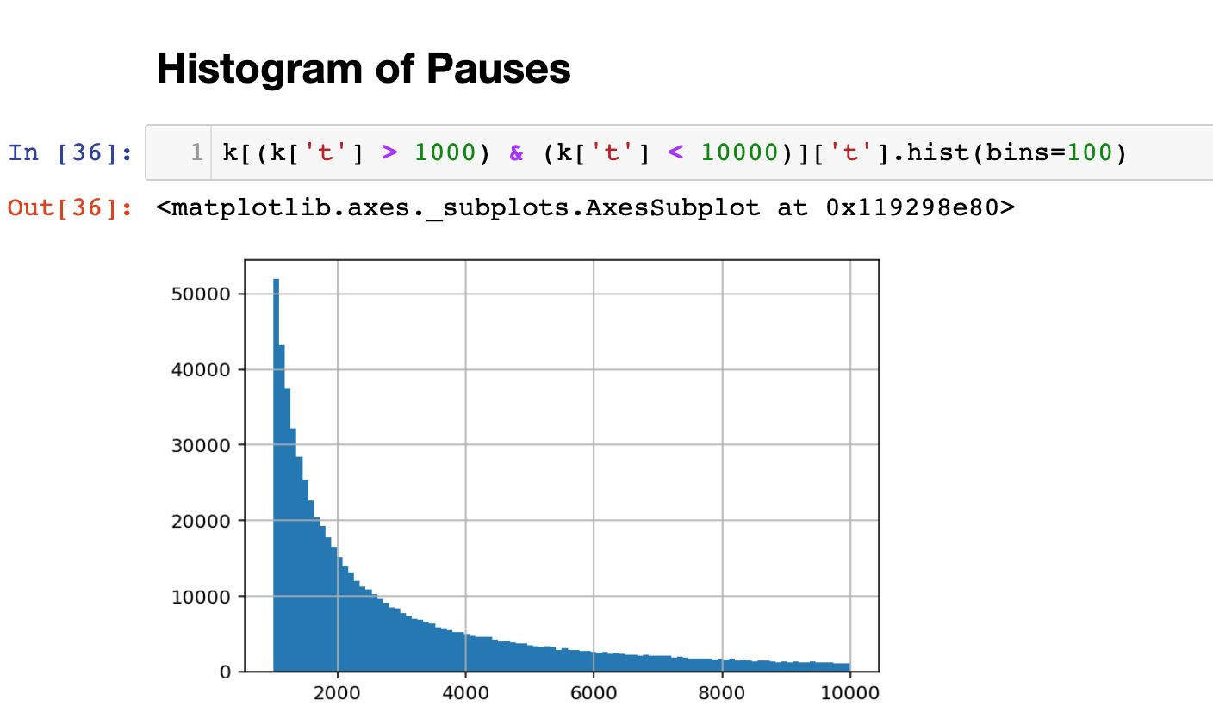
Pauses: 1 second ~ 10 seconds

Slide 11
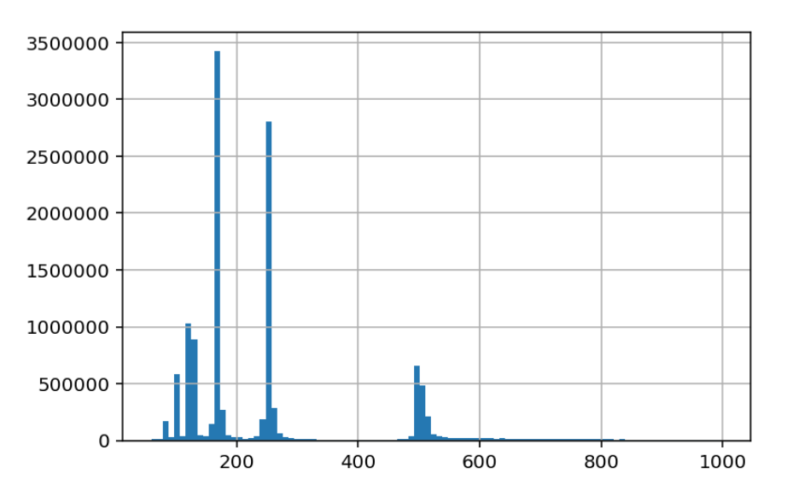
Pauses: ~ 1second
Spikes in ½ seconds, 1/3 seconds, ¼ seconds, 1/5 seconds, 1/6 seconds….
Due to dividing time when there were multiple characters in one keystroke (etherpad can only record every ½ seconds)
--> Potential problem when analyzing the within word keystrokes

Slide 12
Timeline
Date | Plan
5 June | Finish preprocessing ( remove copy-paste, clean data)
6-7 June | Add visualization/stats & Develop measures
11 -14 June | Analyze measure 1 in depth (stats, correlation with cognitive process, text complexity, etc.)
17-21 June | Analyze measure 2 in depth
24-28 June | Analyze measure 3 in depth
1-5 July | Analyze measure 4 (n-grams) in depth
8-12 July | Review over the analysis and find meaningful conclusion
15-17 July | Prepare for the Symposium

